Slide 1
INSTRUCTIONS
Use Font size 22 to 28 and Font Style Times New Roman (body)
Do not change the Template: Heading / Title of the slides
Do not change font style or colours
Do not copy paste paragraphs: use only Bullet Points
Maximum slide Limit is 20 only
As per the number of supervisor allotted adopt slide-2 or slide-3
Please display the required meaningful Content or images or tables
Change the footer accordingly using insert tab then click on header & footer tab and edit it
Save the PPT with Register No, Dept and Review no, example: 23xxxxxxxxx_CSE

Slide 2

Title:CAREERS BUILT ON SMART CONNECTIONS
Student Name: Degala Satvarsh
Student ID: 2520090080
Cluster:3
Section: 12
Under the Guidance
of
Supervisor Name: Dr. N.CHAITANYA KUMAR
PROFESSOR
Department of CSE

Slide 3
OUTLINE
Abstract
Existing System
Proposed System
System Architecture
Project Modules
Objectives
Co’s Attainments - FWD
Co1
Co2 …….. 5. Co5
Co’s Attainments - DSA
Co1
Co2 …….. 5. Co5
Screen Shots for FWD & DSA
Conclusion
Geo-Tagged Photos

Slide 4
Abstract
The project “Career Build on Smart Connections” is a web-based platform designed to help students and young professionals grow their careers by building meaningful professional relationships. The platform focuses on the importance of networking, mentorship, and access to career opportunities such as internships and job openings. By encouraging users to connect with professionals and mentors, the system helps individuals gain valuable career guidance, improve their skills, and discover new opportunities in their fields of interest.
The system allows users to create profiles, build professional connections, and access career-related information in an organized and efficient manner. Opportunities such as internships and job openings are presented in a structured way so that users can easily discover options that match their interests and career goals. The platform also encourages mentorship by enabling experienced professionals to guide students in improving their skills, preparing for interviews, and understanding industry expectations.

Slide 5
Existing System
Students mainly rely on traditional methods to search for internships and job opportunities.
Career information is spread across different platforms such as social media, job portals, and personal contacts.
There is no single platform dedicated to connecting students with mentors and professionals.
Finding relevant career guidance and mentorship can be difficult for students.
Opportunities are not always organized, making it hard for users to quickly identify suitable options.
Communication between students and experienced professionals is limited.

Slide 6
Proposed System
A web-based platform designed to help students and young professionals build strong career connections.
Provides a centralized system to explore internships, job opportunities, and career resources.
Allows users to create profiles and connect with mentors and professionals.
Enables efficient searching and organized display of opportunities and professional connections.
Encourages mentorship where experienced professionals can guide students in their career paths.
Provides a structured environment to manage professional relationships and networking activities.

Slide 7
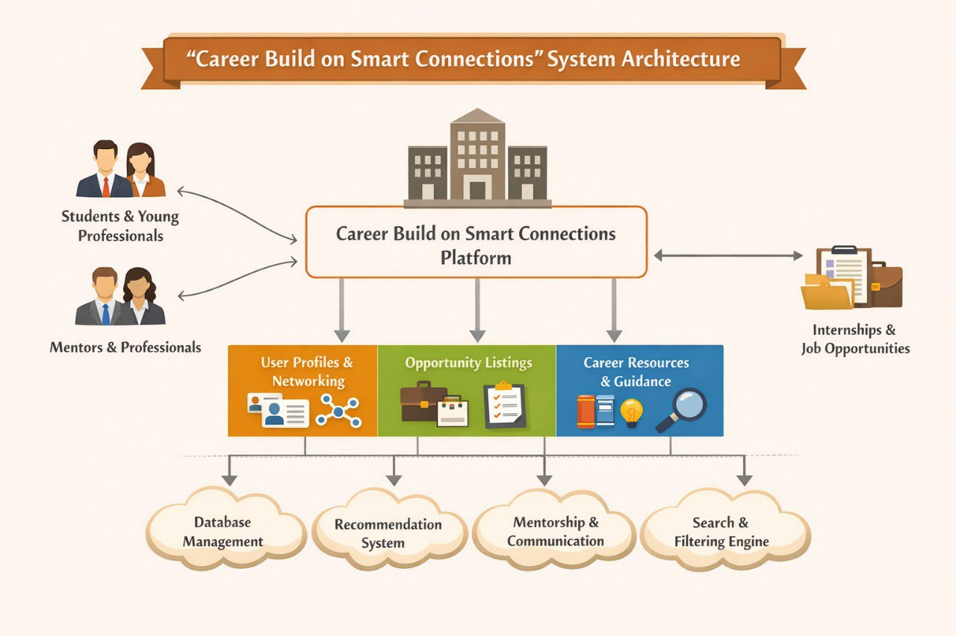
System Architecture

Slide 8
Project Modules
User Registration & Login Module - Allows users to create an account and securely log in to the platform.
User Profile Management Module - Enables users to create and update their professional profiles.
Networking Module - Allows users to connect with other students, mentors, and professionals.
Mentorship Module - Connects students with experienced professionals who can guide them.
Data Management Module - Stores and manages user profiles, connections, and opportunities.

Slide 9
Objectives
To develop a platform that helps students and young professionals build professional connections.
To provide easy access to internships, job opportunities, and career resources.
To encourage networking between students, mentors, and industry professionals.
To help users receive career guidance and mentorship from experienced professionals.
To organize and present career-related information in a structured and user-friendly way.
To support users in improving their skills and preparing for future career opportunities.

Slide 10
CO’s ATTAINMENT-FWD
CO1:
Internet and HTML concepts are used to create the basic structure of the website and connect it to the web using HTTP/HTTPS protocols.
CSS styling is used to design the website layout, colors, fonts, and spacing to make the interface visually appealing.
CO2:
HTML forms and input elements are used to collect user details such as account creation and login information.
CSS layouts like Flexbox, Grid, and responsive design are used to organize website sections and make the site work on different devices.
CO3:
JavaScript fundamentals are used to add logic and control the behavior of the website features.
Objects and arrays are used to store and manage website data such as user information and content.

Slide 11
CO4:
DOM manipulation and event handling are used to make the website interactive when users click buttons or submit forms.
Browser storage and asynchronous programming are used to store user data and handle background tasks smoothly.
CO5:
JavaScript validation and API integration are used to process user inputs and connect the website with external services.
Optimization, SEO meta tags, and deployment techniques are used to improve website performance and make it accessible online.

Slide 12
CO’s ATTAINMENT-DSA
CO1:
Searching algorithms are used in the search feature of the website to quickly find opportunities or profiles.
Sorting algorithms are used to arrange results like jobs, mentors, or connections efficiently.
CO2:
List and linked list structures are used for storing and managing user data dynamically.
Linked lists help in handling multiple connections, profiles, or posts in the platform.
CO3:
Stacks are used in the system logic for processing expressions and managing operations.
Queues are used to handle requests and manage tasks in an ordered manner.

Slide 13
CO4:
Hashing is used for fast data retrieval like searching users or login verification.
Priority queues and heaps help rank or prioritize important data such as trending opportunities
CO5:
Efficient data structures are used to improve overall system performance and scalability of the website.
Advanced techniques help in optimizing data storage and improving response time for user requests.

Slide 14
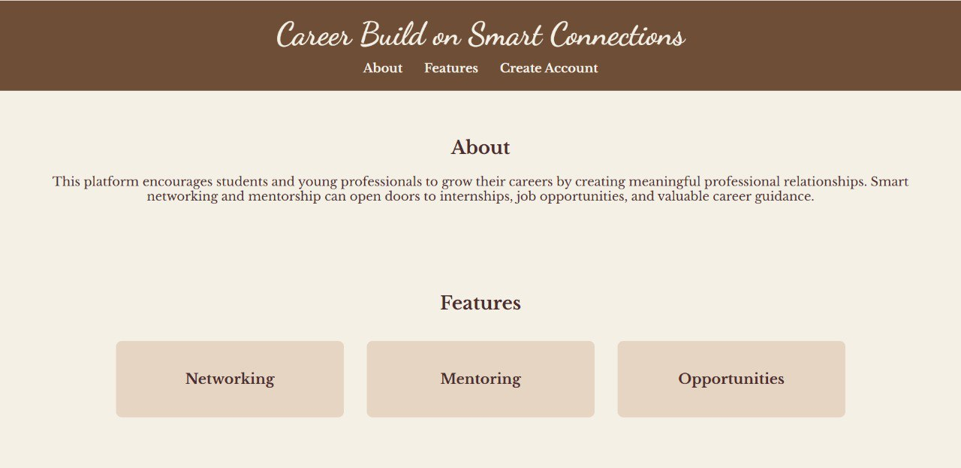
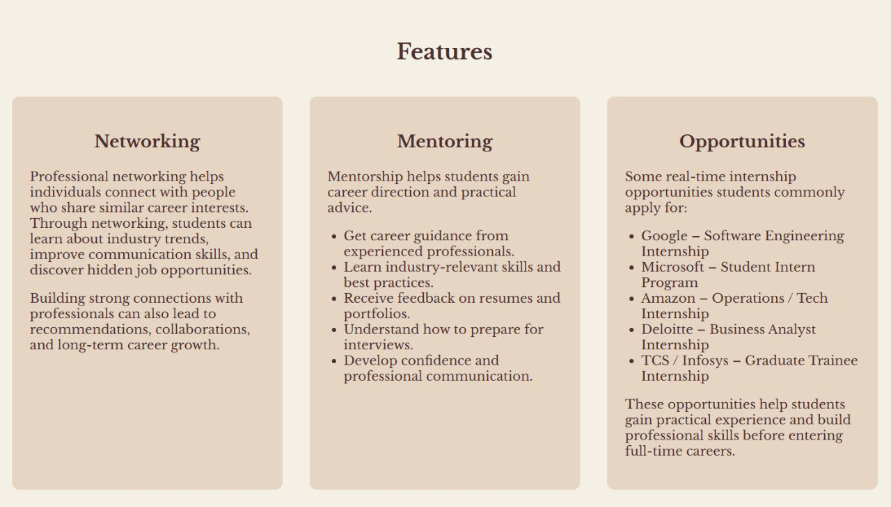
Screenshots for FWD & DSA

Slide 15
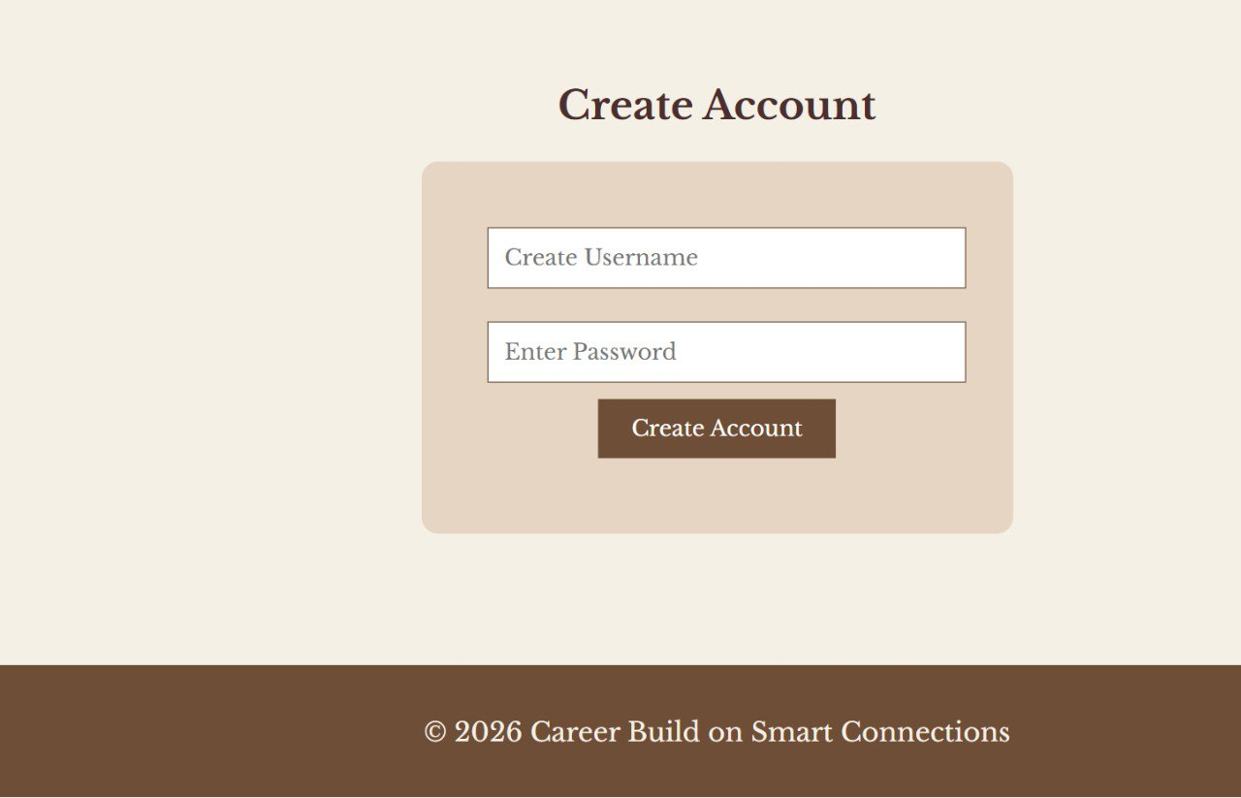
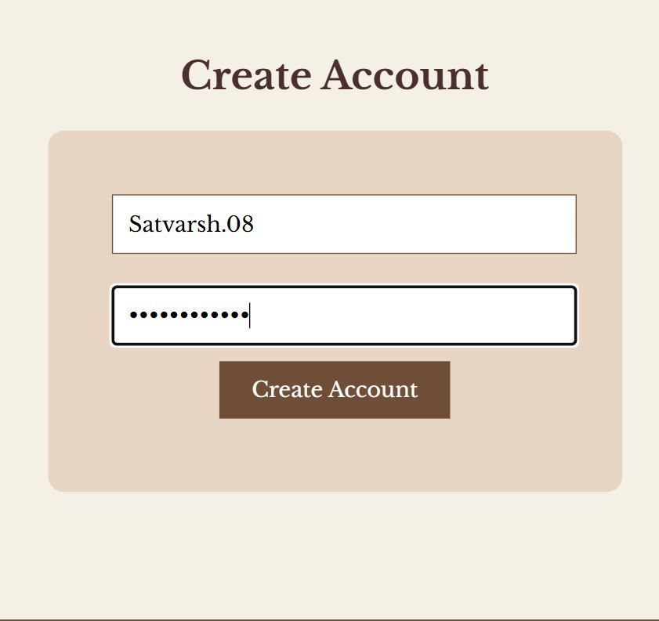

Slide 16
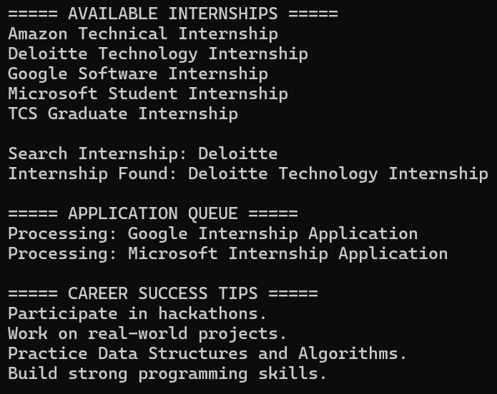
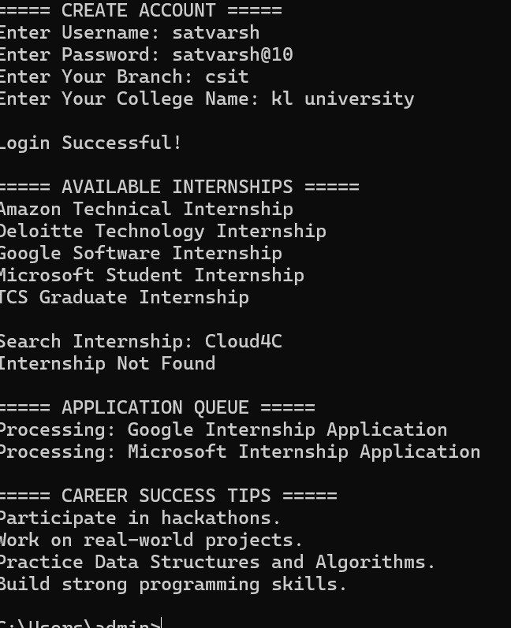
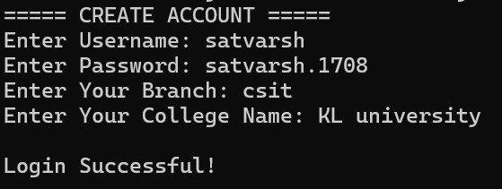

Slide 17
Conclusion
The Career Build on Smart Connections platform helps students and young professionals build meaningful professional relationships.
It provides a centralized space to explore internships, job opportunities, and career guidance.
The platform encourages networking and mentorship between students and experienced professionals.
It organizes career-related information in a clear and accessible way, making it easier for users to find relevant opportunities.
By connecting individuals and promoting knowledge sharing, the system supports personal and professional growth.
Overall, the platform aims to help users make informed career decisions and build a strong foundation for their future.

Slide 18
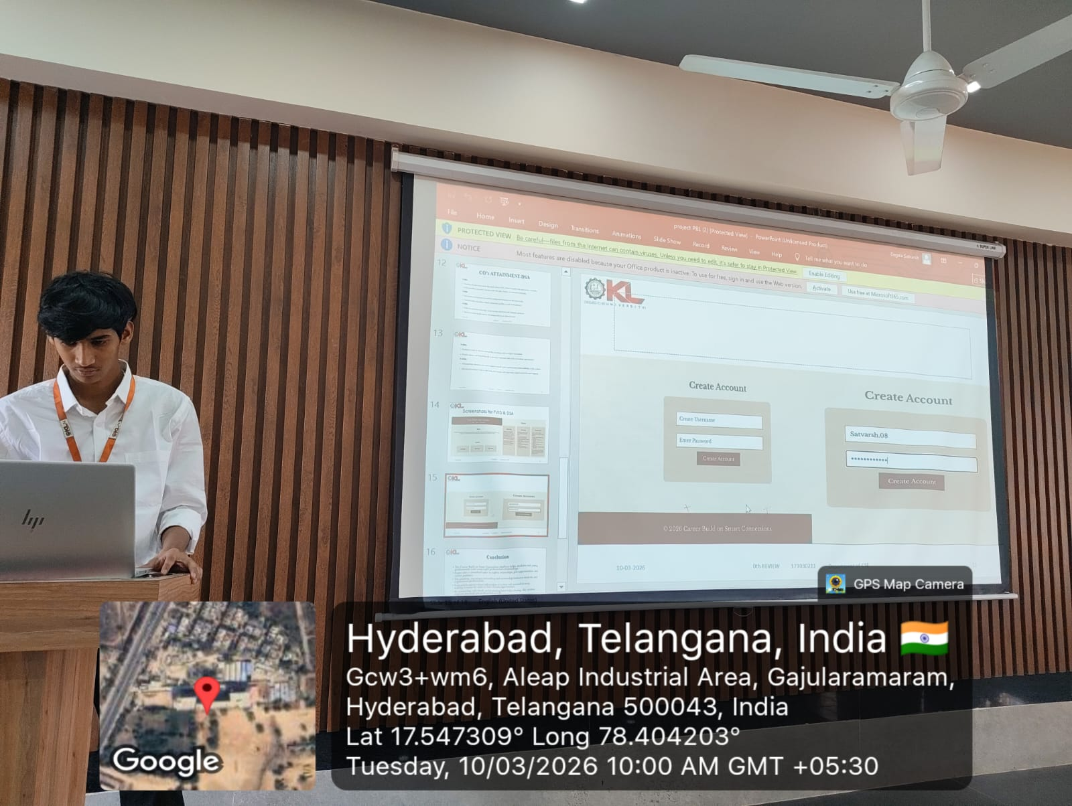
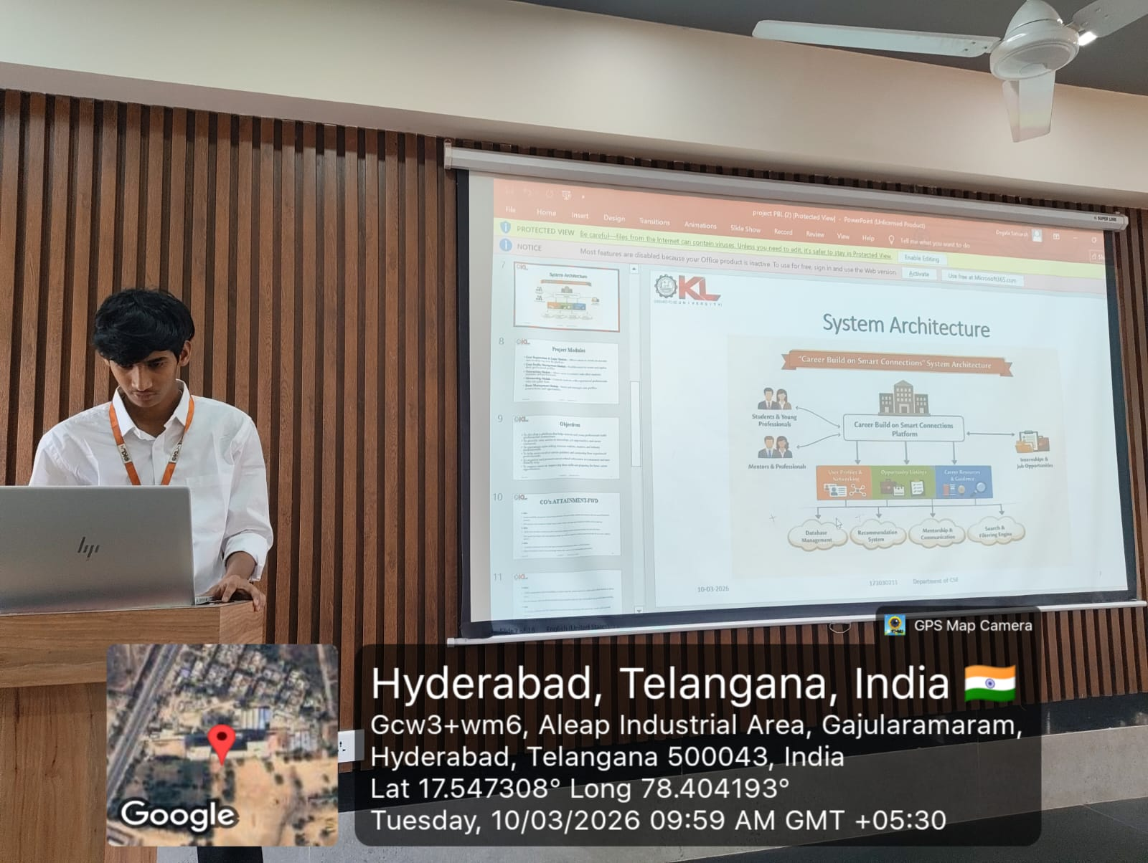
Geo- Tag Photos

Slide 19
THANK YOU

